Slide 1

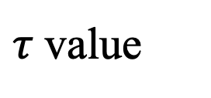

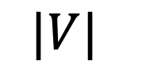


1,200
$τ$ value
0.8
900
0.6
0.4
Running time (sec)
600
0.2
300
0
$$2^{1}K$$
$$2^{2}K$$
$$2^{3}K$$
$$2^{4}K$$
$$|V|$$

